Slide 1
Class 8: Probabilistic weather forecasting with NNs via scoring rules

Slide 2
Outline
Motivation & Calibration
Proper scoring rules: Brier, Log, CRPS
Calibration & sharpness diagnostics
CNN architectures for probabilistic outputs
LSTM architectures for probabilistic outputs
Manual & framework implementations
Training results & calibration diagrams
Ensembles, hyperparameters & variants
Applications & best practices
Summary & further reading

Slide 3
Motivation
Point
Deterministic forecasts provide a single point estimate
Probabilistic forecasts assign a distribution to the future – essential for risk‑aware decisions
Calibration measures statistical consistency between predicted and observed distributions
Sharpness reflects the concentration of the predictive distribution; the goal is sharp and calibrated forecasts
Distribution

Slide 4
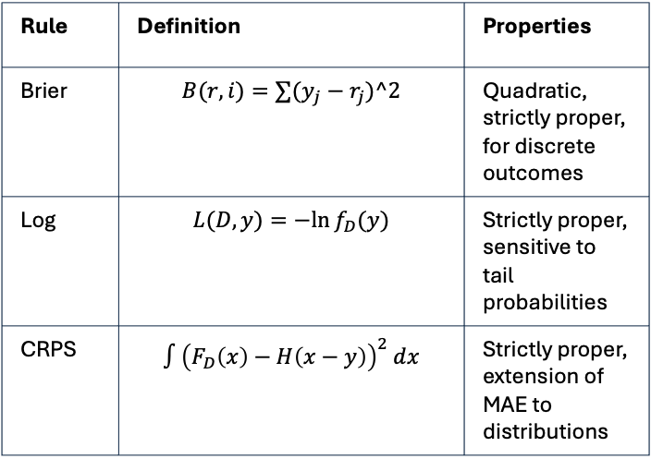
Proper scoring rules
Scoring rules evaluate probabilistic forecasts by comparing the predicted distribution to the observed value.
A scoring rule is strictly proper if the expected score is minimised when the forecast distribution equals the true distribution.
Proper scoring rules encourage calibration and discourage hedging.
Rule | Definition | Properties
Brier | $$B(r,i)=∑(y_{j}−r_{j})^2$$ | Quadratic, strictly proper, for discrete outcomes
Log | $$L(D,y)=−ln⁡f_{D}(y)$$ | Strictly proper, sensitive to tail probabilities
CRPS | $$∫{\left(F_{D}\left(x\right)−H\left(x−y\right)\right)}^{2} dx$$ | Strictly proper, extension of MAE to distributions

Slide 5
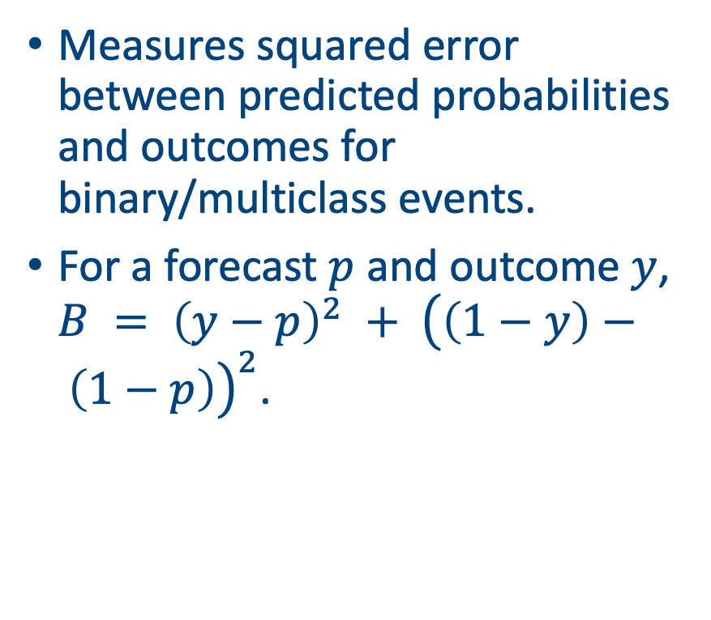
Brier score
Measures squared error between predicted probabilities and outcomes for binary/multiclass events.
For a forecast $p$ and outcome $y$, $B = {\left(y−p\right)}^{2} + {\left(\left(1−y\right)− \left(1−p\right)\right)}^{2}$.

Slide 6
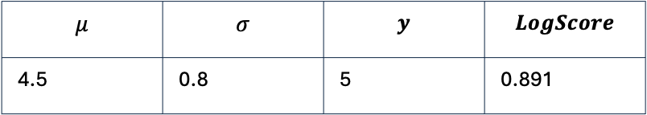
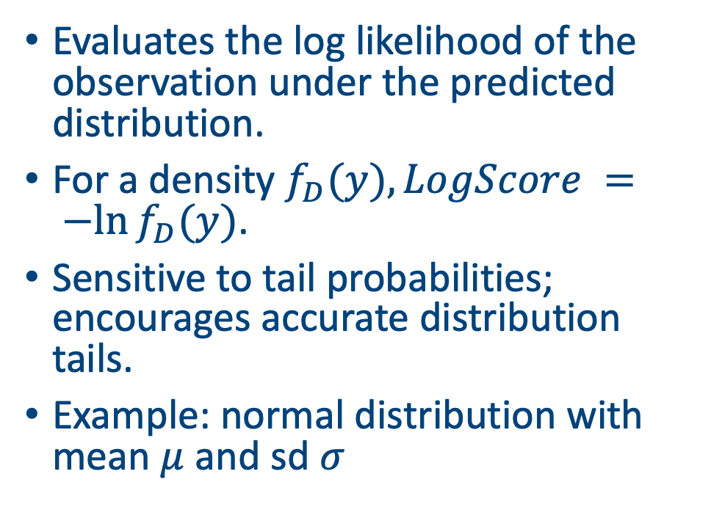
Logarithmic score
Evaluates the log likelihood of the observation under the predicted distribution.
For a density $f_{D}(y), LogScore = −ln⁡f_{D}(y)$.
Sensitive to tail probabilities; encourages accurate distribution tails.
Example: normal distribution with mean $μ$ and sd $σ$
$$μ$$ | $$σ$$ | $$y$$ | $$LogScore$$
4.5 | 0.8 | 5 | 0.891

Slide 7
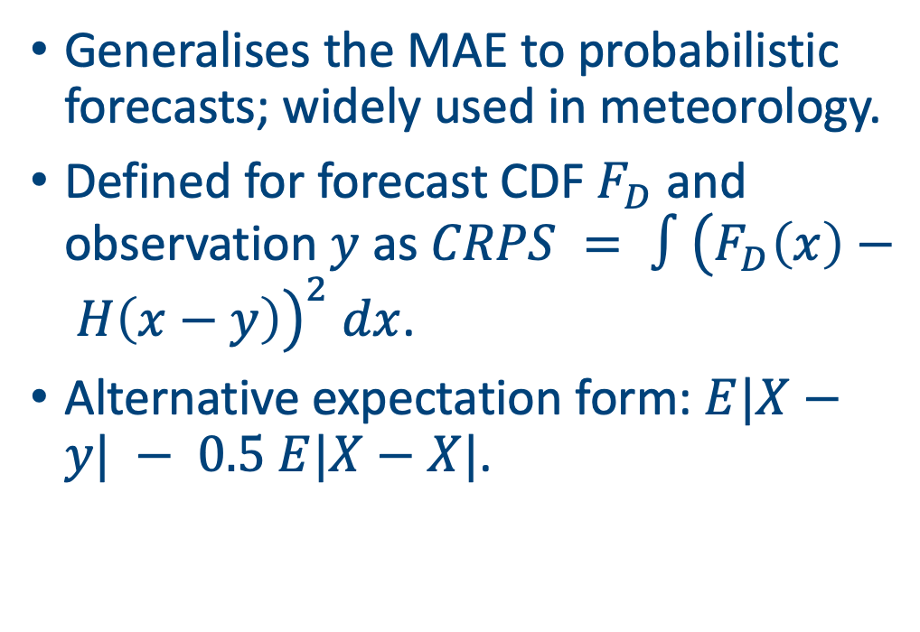
Continuous ranked probability score (CRPS)
Generalises the MAE to probabilistic forecasts; widely used in meteorology.
Defined for forecast CDF $F_{D}$ and observation $y$ as $CRPS = ∫{\left(F_{D}\left(x\right)− H\left(x−y\right)\right)}^{2} dx$.
Alternative expectation form: $E|X−y| − 0.5 E|X−X|$.

Slide 8
CRPS: example
Consider a forecast with two equiprobable outcomes {2, 5} and an observation y = 4.
Using the expectation form: CRPS = E|X−y| − 0.5 E|X−X|.
Computed CRPS = 0.750
Outcome | |X−y| | Pairwise terms
2 | 2.0 | 3.0, 0.0
5 | 1.0 | 3.0, 0.0

Slide 9
Calibration and sharpness
Reliability: predicted probabilities match observed frequencies.
Sharpness: predictive distributions are as concentrated as possible.
Aim: reliability diagrams close to diagonal and narrow prediction intervals.
Reliability diagram

Slide 10
Example CNN architecture for probabilistic forecasting
1D CNNs learn local temporal patterns in weather sequences.
Final dense layer outputs parameters of a probability distribution (e.g., mean and variance of a Gaussian).
Loss functions built from scoring rules train the network to produce calibrated distributions.
Input
series
Conv
filters
Pooling
Dense→
mu, sigma

Slide 11
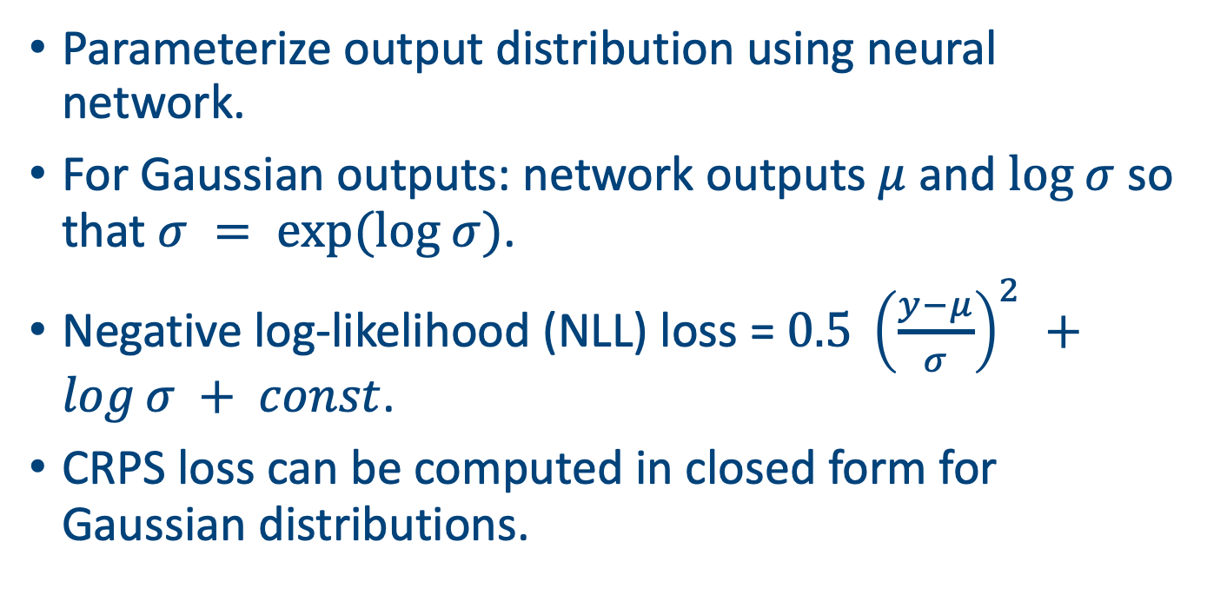
Probabilistic Output Layers
Parameterize output distribution using neural network.
For Gaussian outputs: network outputs $μ$ and $log σ$ so that $σ = exp(log σ)$.
Negative log-likelihood (NLL) loss = $0.5 {\left(\frac{y−μ}{σ}\right)}^{2} +log⁡σ + const$.
CRPS loss can be computed in closed form for Gaussian distributions.

Slide 12
LSTMs and probabilistic forecasting
LSTMs capture long‑range temporal dependencies via gated units.
Similar to CNNs, a dense head outputs distribution parameters (mu, sigma).
Use scoring rule‑based losses (NLL, CRPS) to train for calibrated forecasts.

Slide 13
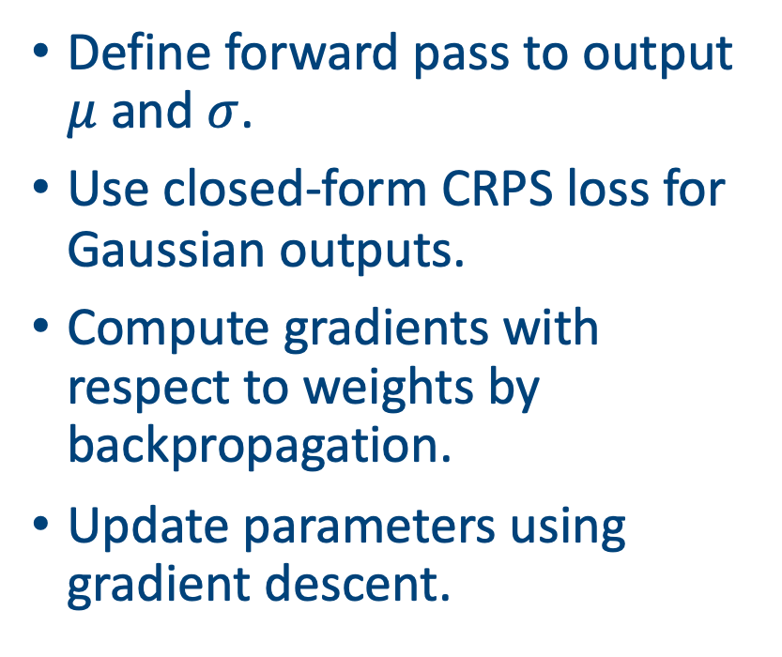
Forward pass implementation
Define forward pass to output $μ$ and $σ$.
Use closed‑form CRPS loss for Gaussian outputs.
Compute gradients with respect to weights by backpropagation.
Update parameters using gradient descent.
# x: batch of input sequences
# y: batch of observations
# theta: weights of CNN
for epoch in range(E):
# forward pass: compute mu, sigma from CNN(x, theta)
mu, sigma = cnn_forward(x, theta)
# compute CRPS using closed form for Gaussian
loss = mean(crps_gaussian(mu, sigma, y))
# backward pass: compute gradients dloss/dtheta
grad = cnn_backward(x, mu, sigma, y)
# update weights
theta = theta - alpha * grad

Slide 14
Example using Pytorch

Slide 15
Pytorch results

Slide 16
Pytorch calibration diagnostics

Slide 17
Model averaging and ensembles
Averaging multiple models can improve calibration and sharpness.
Use ensembles of CNNs/LSTMs trained with different initialisations.
Alternatively combine deterministic models (mean forecasts) with probabilistic postprocessing (e.g., quantile regression).
Average CRPS (lower is better)

Slide 18
Hyperparameters and tuning
Window size: number of past days fed into the network.
Network depth & filters: number of convolutional layers and LSTM units.
Output distribution type: Gaussian, mixture, quantile regression.
Scoring rule: choose NLL, CRPS, or quantile loss depending on the application.
Learning rate & regularisation: optimize using validation data.

Slide 19
Other approaches
Mixture Density Networks (MDN): output mixture weights, means & variances.
Quantile Regression Networks: output specific quantiles using pinball loss.
Generative models (GANs/VAEs): sample entire distributions.
Bayesian neural networks: place priors over weights to capture uncertainty.

Slide 20
Applications in weather and climate
Temperature & precipitation forecasting for energy demand.
Wind speed forecasts for renewable power integration.
Flood risk and extreme event prediction using tail‑focused distributions.
Ensemble postprocessing for numerical weather prediction models.

Slide 21
Limitations
Heavy tails and extreme events are difficult to model accurately.
Probabilistic calibration may fail under distributional shift.
Computational cost of training CRPS/NLL losses for large models.
Interpretability and communicating probabilistic forecasts to stakeholders.

Slide 22
Best practice
Normalize inputs and standardise target variables.
Use early stopping and cross‑validation to prevent overfitting.
Evaluate with multiple scoring rules and calibration diagnostics.
Calibrate deterministic models using isotonic regression or Platt scaling when appropriate.
Communicate probabilistic forecasts with clear visualisations (intervals, fan charts, reliability diagrams).

Slide 23
Case study: Graph Attention Network with probabilistic outputs

Slide 24
Comparison of models
Model | Strengths | Limitations
LSTM | Captures long‑range dependencies; simple to implement | May overfit; training slower; calibration depends on output layer
Transformer | Highly parallel; captures global context | Requires larger data; heavier compute; may need calibration tricks
CNN | Efficient; learns local patterns; robust to noise | Limited long‑range context; may need multiple layers
GNN | Handles spatial relations (ie weather stations); message passing | Graph construction overhead; more complex frameworks

Slide 25
Summary
Probabilistic forecasts quantify uncertainty and enable risk‑aware decisions.
Proper scoring rules (Brier, Log, CRPS) provide objective loss functions that encourage calibration.
CNNs and LSTMs can be extended to output distribution parameters and trained with these scoring rules.
Calibration diagnostics (reliability diagrams, PIT histograms) are essential to evaluate forecasts.
Ensembles, proper hyperparameter tuning, and advanced models further improve probabilistic forecasts.

Slide 26
Next class
Run through D4C3_code.ipynb

Slide 27
Afternoon session instructions
(Download the ERA5 1 degree data set from XXX)
Get an LLM to help you write a graph attention network to predict multiple variables across multiple slides
Stay small!
Present your ipynb file in 5 minutes

